Slide 1
Cellular Image Segmentation Methods and Applications
By Tyler Ruch

Slide 2
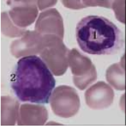
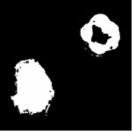
Cellular Image Segmentation
Medical Image Segmentation goals: Study anatomical structure, Identify regions of interest, Measure tissue volume, aid in treatment [1].
Many types of medical images, many different techniques for segmentation of them. Some are supervised, some are unsupervised. Some incorporate biological knowledge, others do not.
In cellular image segmentation, cells/nuclei are automatically identified in images/scans of various structures that contain cells, such as blood and tissue
Figure 1: Cellular segmentation, courtesy of [2]

Slide 3
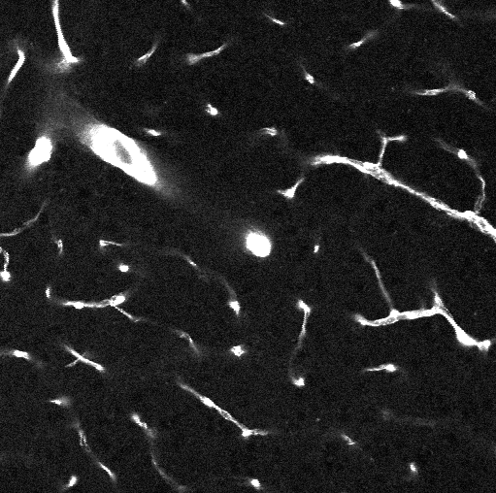
My Cellular Segmentation Goal
Separate out Pericyte and Smooth Muscle Cells in neurovascular microscopic images
Images have noise, cells look similar and have similar shape, images are greyscale
Figure 2: Example of my cellular images– Credit Yongsoo Kim, Penn State College of Medicine

Slide 4
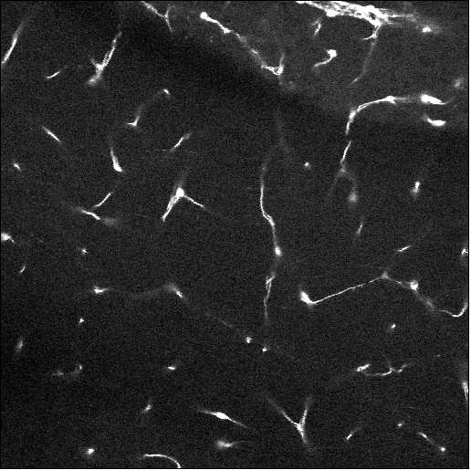
My Cellular Segmentation Goal
Original
Pericyte
Smooth Muscle
Figure 3: In this order: Original image, ground truth pericyte mask, ground truth smooth muscle mask – Credit Yongsoo Kim, Penn State College of Medicine

Slide 5
Techniques for Cellular Segmentation
Edge Detection, using an alteration of the contrast
Region growing, using expert-generated seeds or algorithmically generated seeds
Binary Thresholding, using global, dynamic, or local thresholding algorithms
Mathematical morphology, concavity analysis, and shape detection
Template matching (scanning with a “quintessential” template image)
Artifical Intelligence – CNNs. 2D and 3D CNNS.
“Pipelining” – laying out a sequence of these, and other, operations to achieve an ultimate result

Slide 6
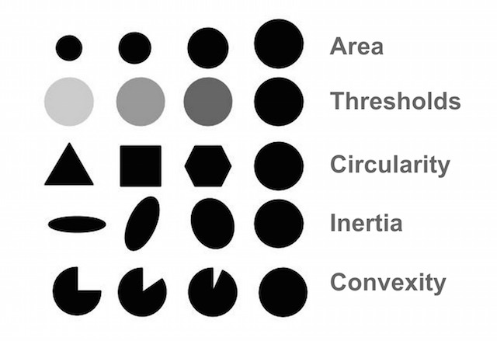
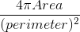
Interesting Shape, Morphologic, and color Features for “blob” detection
Calculate area
Separate by intensity value 0-255
(so, circularity(circle)=1)
Measures elongation
Area of the shape / Area of its convex hull
(convex hull:
smallest set of vertices that contain the shape)
Courtesy of: https://www.learnopencv.com/blob-detection-using-opencv-python-c/

Slide 7
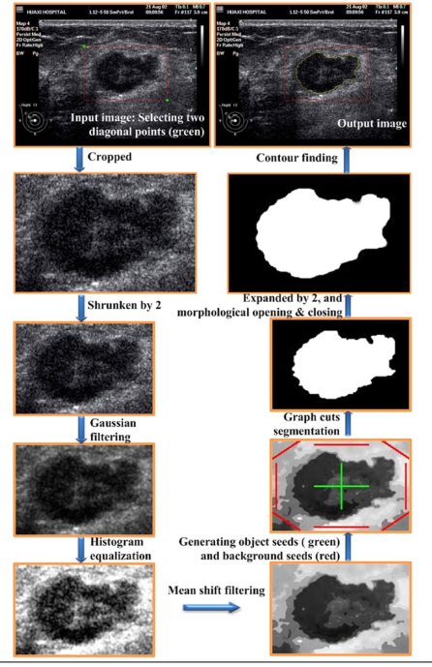
Pipeline Example
Figure 4: An example of the incorporation of various
automated segmentation strategies to segment an ultrasound
Courtesy of [4]

Slide 8
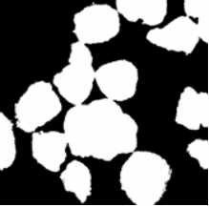
Common Challenges in Cellular Segmentation
Overlapping Regions – huge problem in all methods
Overcoming and eliminating noise – huge problem for thresholding
Small labelled datasets (common problem for all medical imaging segmentation using deep learning)
Image brightness/contrast inconsistency,even distortion across images or within images
(due to imaging devices)
Figure 5: Segmented images with overlapping regions – courtesy [5]

Slide 9
Techniques to Overcome Challenges
Overlapping Regions – calculate centroids with contour analysis and use avg cell radius to separate
Overcoming and eliminating noise – Use 3x3 median filtering or gaussian blurring before thresholding
Small labelled datasets – Use augmentations on the small training data to make larger training data
One common solution: use biological context knowledge and design algorithm pipelines accordingy
Issue with this: only works for the application/dataset it was designed for

Slide 10
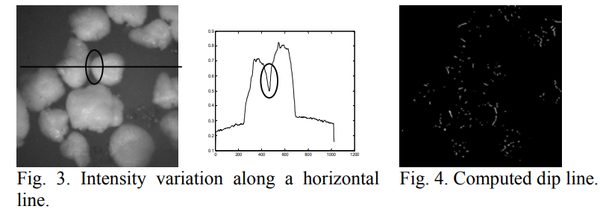
Overlapping Regions, another approach
Use the gradient to detect dips in intensity that appear in the overlapping areas when scanning horizontally. First, calculate any areas in the image that have a sudden dip in intensity:
Courtesy [5]

Slide 11
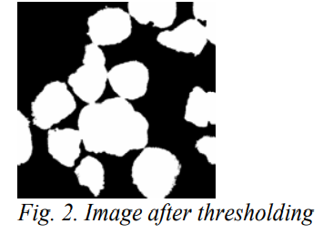
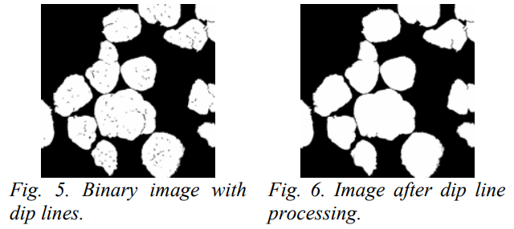
Overlapping Regions, another approach
Then, remove any areas from the mask where an object’s edge touches an area from the sudden-dip image.
Courtesy [5]

Slide 12
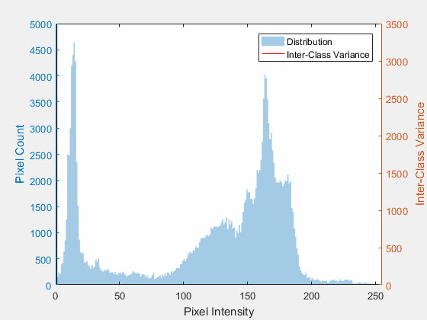
Otsu’s Dynamic Thresholding Method
Method of automatically generating a binary image from a greyscale image by separating background and foreground
Performed by exhaustively searching for the threshold separator that equally separates the image
Done by analyzing the greyscale histogram and finding the value that minimizes the intra-class variance (or maximizes the inter-class variance)
Overcomes inconsistent brightness/contrast problem
Source: https://commons.wikimedia.org/wiki/File:Otsu%27s_Method_Visualization.gif
Courtesy of Lucas(CA)

Slide 13
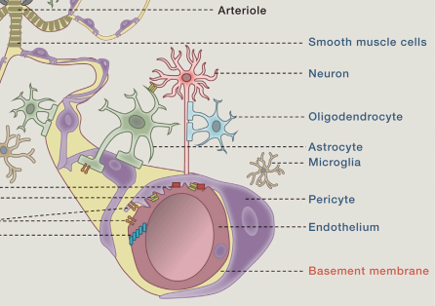
My Biological Context
Both Pericytes and Smooth muscle cells are controlled by neurons, and are used, among their other uses, to control blood flow to the microvessels in the brain [3]
Smooth muscle cells are found surrounding the large arterioles, and pericytes are found surrounding the small arterioles. [3]
Figure 3: Arteriole Structure. Courtesy [3]

Slide 14
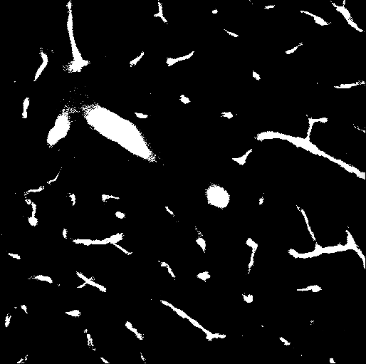
My Biological Context
Figure 4: High contrast image. Notice the Artery structures. – Coutrtesy Yongsoo Kim, Penn State College of Medicine

Slide 15
Concluding Plan
Use the knowledge of the arteriole structure to formulate an automated detection approach that differentiates between Smooth Muscle Cells and Pericytes
Use a combination of automated methods and deep learning
Perhaps formulate a way to detect the vessels in the images, and use this to differentiate

Slide 16
References
[1] N. Sharma, A. Ray, K. Shukla, S. Sharma, S. Pradhan, A. Srivastva, and L. Aggarwal, “Automated medical image segmentation techniques,” Journal of Medical Physics, vol. 35, no. 1, p. 3, 2010.
[2] B. Liu, C. Yin, Z. Liu, and Y. Zhang, “Automatic Segmentation on Cell Image Fusing Gray and Gradient Information,” in 2007 29th Annual International Conference of the IEEE Engineering in Medicine and Biology Society, Lyon, France, 2007, pp. 5624–5627.
[3] Z. Zhao, A. R. Nelson, C. Betsholtz, and B. V. Zlokovic, “Establishment and Dysfunction of the Blood-Brain Barrier,” Cell, vol. 163, no. 5, pp. 1064–1078, Nov. 2015.
[4] Zhou, Z., Wu, W., Wu, S., Tsui, P., Lin, C., Zhang, L., & Wang, T. (2014). Semi-automatic Breast Ultrasound Image Segmentation Based on Mean Shift and Graph Cuts. Ultrasonic Imaging, 36(4), 256-276. doi:10.1177/0161734614524735
[5] J. M. Korath, A. Abbas, and J. A. Romagnoli, “Separating touching and overlapping objects in particle images – A combined approach,” p. 6.

